Slide 1
6.1 Liberty Versus Order in the 1790s
Angela Brown

Slide 2
Describe Alexander Hamilton’s program for dealing with national and state debt.
Explain how the French Revolution divided Americans.
Describe the causes and effects of the Whiskey Rebellion.
Summarize the debate over Jay’s Treaty and the resulting rise of Political Parties.
Learning Targets: I Can…

Slide 3
Bellringer:
Do you consider yourself a Republican, Democrat, Independent or member of a minor political party?
Define the different political goals of these parties.
Key Terms:
Tariff, interest, strict construction, loose construction, neutral, Whiskey Rebellion, Jay’s Treaty, political party
Lesson Focus

Slide 4
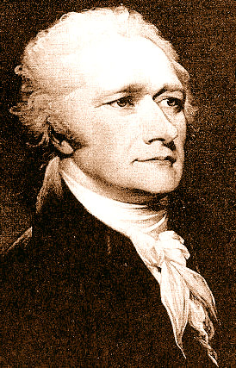
Secretary of the Treasury Hamilton was a supporter of strong national power.
He had little faith in the people.
He believed the Constitution was not enough to preserve the new nation.
He thought the government had to expand its role and actively direct the development of the American Economy.
Hamilton’s Program
hamiltonlives.com

Slide 5
Hamilton proposed a controversial plan.
In 1790, after months of debate, Congress approved Hamilton’s plan for the national government to take on the debts acquired by the states during the Revolution.
Southern states did not want to be responsible for northern debts.
Hamilton struck a deal…Hamilton would gain northern support to locate the nation’s capital in the South in exchange for Southern support.
In 1790 Congress approved both the debt pan and a plan to locate the capital on the banks of the Potomac.
Hamilton’s Plan

Slide 6
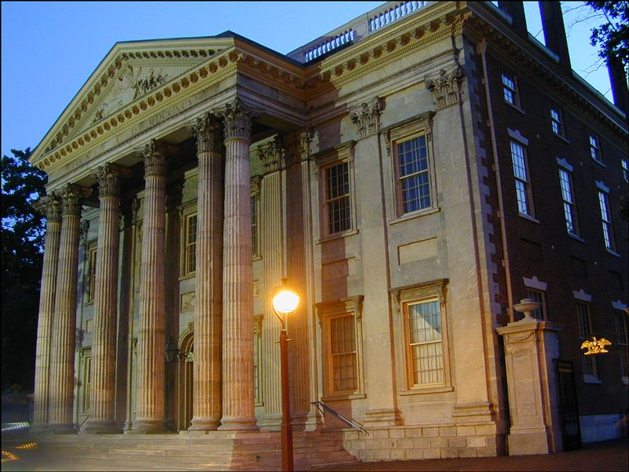
The plan was controversial for another reason…the federal government already had a huge debt of about $50 million.
Most of the state and national debt was owed to European banks and to American merchants and speculators, or people who take a financial risk in the hope of future profit.
goingglobaleastmeetswest.blogspot.com
Hamilton’s Strategy

Slide 7
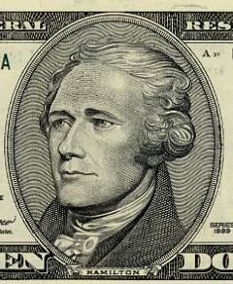
Hamilton knew that these creditors, or lenders, would not want any government that owed them money to collapse.
Creditors would care about the states.
If the U.S. owed creditors the money, they would be less interested in the individual states and more concerned with the future of the U.S. as a whole.
clarity2009.blogspot.com
On the $10 bill??

Slide 8
Hamilton outlined a specific budget and set up a regular payment plan.
In 1789, Congress created a tariff – a tax on imported goods.
In 1791, Congress placed a tax on whiskey.
Most of this money went to pay the expenses of the government, such as salaries.
Hamilton wanted to put some of it into a special fund to pay creditors a little money every year.
The government paid them interest – an extra sum of money that borrowers pay creditors in return for the loan..
Congress established the Bank of the U.S. in 1791 to handle this debt.
The National Bank

Slide 9
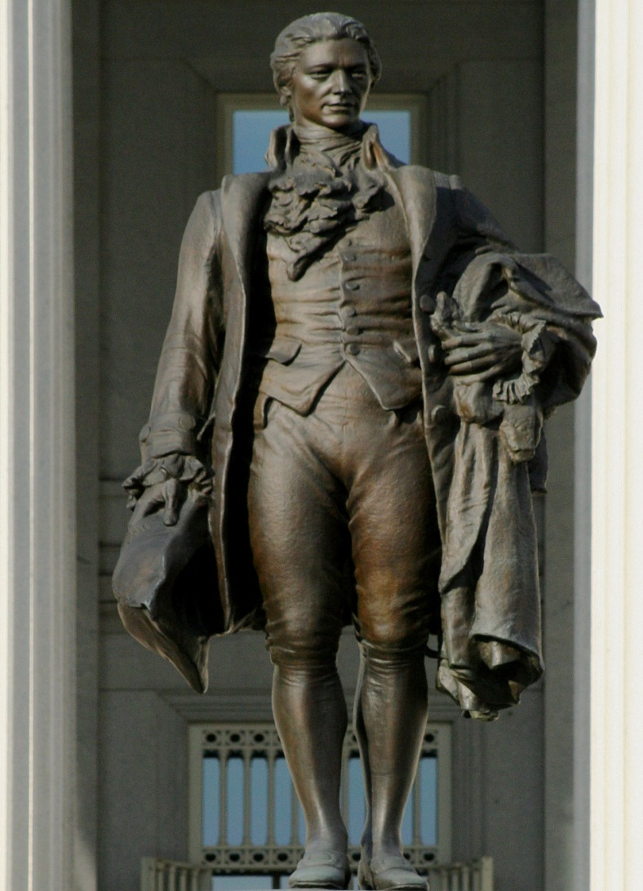
Hamilton transformed the debts of the state governments into a long-term investment in the U.S. government.
The country’s creditors now held an interest in the stable functioning of the government.
Long-Term Investment
patriotspokenword.com

Slide 10
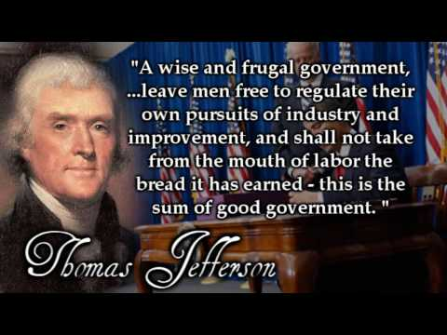
Many Americans did not like Hamilton’s plan.
They objected to the interference of the federal government in local and state affairs.
They also disliked the new taxes.
goodreads.com
Hamilton’s Opponents

Slide 11
Opponents of the Washington administration regarded Hamilton’s policy of taxation and regulation similar to the one the British had proposed in the 1760s.
Washington’s elegant style of presidency suggested a return to aristocracy and monarchy.
Secretary of State Jefferson opposed Hamilton’s plan finding himself in the minority opinion of the President’s Cabinet.
Jefferson resigned in 1793.
Jefferson favored strict construction meaning he believed the government should not do anything that the Constitution did not specifically say it could do.
Thomas Jefferson

Slide 12
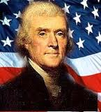
Hamilton believed in loose construction meaning the government could do anything the Constitution did not say it could not do.
Jefferson believed Hamilton and his Federalist allies were betraying the American Revolution.
Jefferson had more faith in the people than in their government.
s9.com

Slide 13
The Revolution was committed to “liberty, fraternity, and equality.
By the early 1790s, disagreement over how to make these ideals reality led to a prolonged period of violence called the Reign of Terror.
Thousands of people were executed including King Louis XVI and Queen Marie Antoinette.
The French Revolution

Slide 14
Federalists tended to oppose it, seeing it as an example of a democratic revolution gone wrong.
Jefferson’s supporters viewed it as an extension of the American Revolution.
Though upset by its violence, they applauded the rejection of government by Kings and its acceptance of republican government.
American Reactions

Slide 15
Outbreak of war between Great Britain and France created the problem whose side to take.
The nation could not afford to offend the British, whose navy dominated the sea.
Few people wanted to abandon the French, who had helped Americans during the War for Independence.
The most sensible strategy was to remain neutral.
In April 1793, after having been reelected for a second term as President, Washington issued a Proclamation of Neutrality.
The U.S. would not take sides in the struggle.
Choosing Sides

Slide 16
In western Pennsylvania and other frontier areas, many people refused to pay the tax on whiskey.
Whiskey was of critical importance to the frontier economy.
It was one of the only products farmers could make out of corn that could be transported to market without spoiling.
It was used as a kind of currency, like tobacco leaves in colonial Virginia.
In 1794 opposition to the whiskey tax was so strong that western Pennsylvania appeared to be in a state of rebellion against the authority of the federal government.
The Whiskey Rebellion

Slide 17
The rebels closed courts and attacked tax collectors.
Washington and Hamilton saw the rebellion as an opportunity to demonstrate the power of the U.S. government.
In the summer of 1794, Washington gathered an army of over 12,000 men.
General Lee accompanied by Hamilton led the army to Pittsburgh and the rebellion soon dissolved.
Washington’s tough response demonstrated that the young American government was committed to enforcing its laws.
The Whiskey Rebellion

Slide 18
In 1794 the debate over whether the U.S. should be neutral rose to a fever pitch.
Washington sent Chief Justice John Jay to London to negotiate an agreement with the British.
In the agreement, called Jay’s Treaty, Britain agreed to leave the forts it occupied in the Northwest Territory.
Other provisions aimed at expanding trade between the two nations.
Jay was unable to convince the British to end their practice of stopping American ships on the high seas and searching them for British subjects.
Jay’s Treaty

Slide 19
Critics complained that the treaty contained no protection for American shipping.
Many Americans saw the treaty as a sell-out to the hated British.
Congress ratified the treaty in 1795.
The Federalists had established their economic program, suppressed the Whiskey Rebellion, and ensured peace with Great Britain.
Yet in so doing, they had lost the support of a great many Americans.
Jay’s Treaty

Slide 20
As early as 1793, artisans and professional men were forming what were called Democratic Societies to oppose the Federalists.
Jefferson, and various state leaders were furiously promoting resistance to the Federalists in letters to one another.
Some leaders also encouraged newspaper attacks on the Washington administration.
The Jeffersonian Republicans

Slide 21
Originally these critics were called Republicans or Democratic-Republicans because they stood for a more democratic republic.
To avoid confusing them with the modern Republican party, historians call them Jeffersonian Republicans.
They and the Federalists were the first political parties in the U.S.
A political party in a group of people who seek to win elections and hold public office in order to control government policy and programs.
Jeffersonian Republicans

Slide 22
In the midst of the criticism, Washington chose not to run again setting a precedent.
Washington’s VP, John Adams, ran for President against Thomas Jefferson in 1796.
Adams gained a majority of electoral votes and was elected President.
Jefferson finished second and became VP.
In his Farewell Address of 1796, Washington warned against competing political parties.
President Washington

Slide 23
Who opposed the Federalists? Why?
Create an outline listing the major actions of the federal government between 1791-1796.
What did the federal government demonstrate in its reaction to the Whiskey Rebellion?
Exit Slip

